Slide 1
Chapter 6. Classification and Prediction
What is classification? What is prediction?
Issues regarding classification and prediction
Classification by decision tree induction
Bayesian classification
Rule-based classification
Classification by back propagation
Support Vector Machines (SVM)
Associative classification
Lazy learners (or learning from your neighbors)
Other classification methods
Prediction
Accuracy and error measures
Ensemble methods
Model selection
Summary
Data Mining: Concepts and Techniques

Slide 2






Nearest Neighbor Classifiers
Basic idea:
  If it walks like a duck, quacks like a duck, then it’s probably a duck
Compute Distance
Test Record
Training Records
Choose k of the “nearest” records
Data Mining: Concepts and Techniques

Slide 3

Nearest neighbor method
Majority vote within the k nearest neighbors
new
K= 1: brown
K= 3: green
Data Mining: Concepts and Techniques

Slide 4
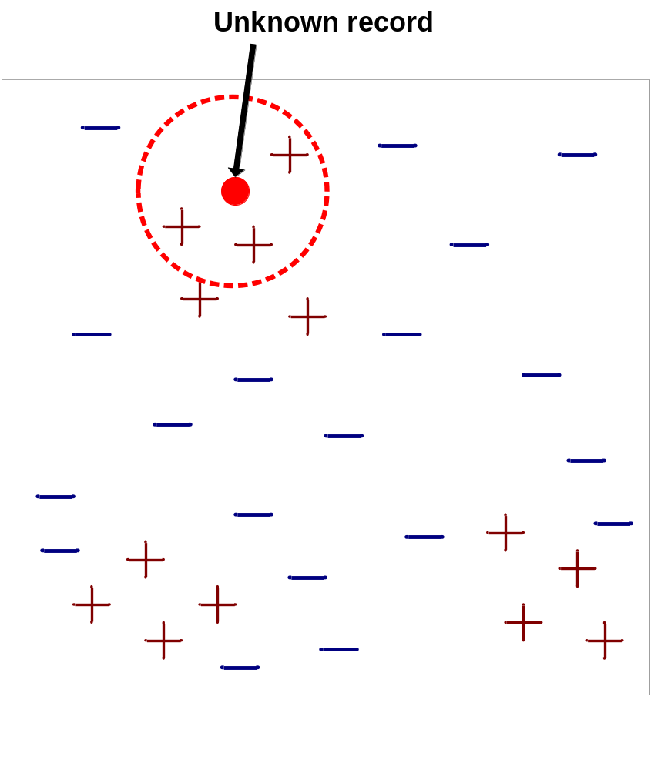
Nearest-Neighbor Classifiers
Requires three things
  The set of stored records
  Distance Metric to compute distance between records
  The value of k, the number of nearest neighbors to retrieve
To classify an unknown record:
  Compute distance to other training records
  Identify k nearest neighbors
  Use class labels of nearest neighbors to determine the class label of unknown record (e.g., by taking majority vote)
Data Mining: Concepts and Techniques

Slide 5

Definition of Nearest Neighbor
K-nearest neighbors of a record x are data points that have the k smallest distance to x
Data Mining: Concepts and Techniques

Slide 6
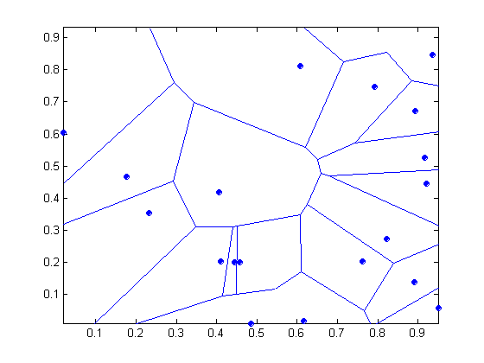
1 nearest-neighbor
Voronoi Diagram
Data Mining: Concepts and Techniques

Slide 7
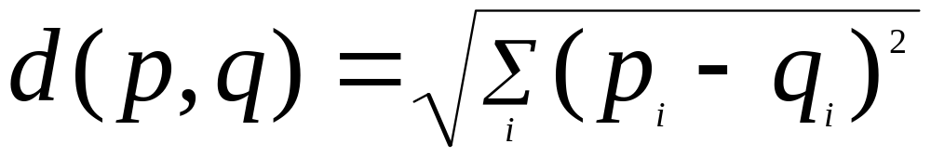
Nearest Neighbor Classification
Compute distance between two points:
  Euclidean distance
Determine the class from nearest neighbor list
  take the majority vote of class labels among the k-nearest neighbors
  Weigh the vote according to distance
    weight factor, w = 1/d²
Data Mining: Concepts and Techniques

Slide 8
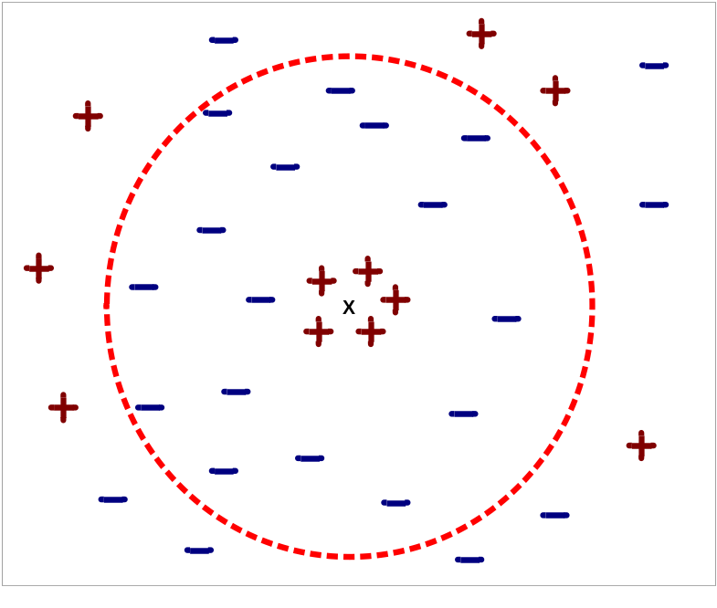
Nearest Neighbor Classification…
Choosing the value of k:
  If k is too small, sensitive to noise points
  If k is too large, neighborhood may include points from other classes
Data Mining: Concepts and Techniques

Slide 9
Nearest Neighbor Classification…
Scaling issues
  Attributes may have to be scaled to prevent distance measures from being dominated by one of the attributes
  Example:
    height of a person may vary from 1.5m to 1.8m
    weight of a person may vary from 90lb to 300lb
    income of a person may vary from $10K to $1M
Data Mining: Concepts and Techniques

Slide 10
Nearest Neighbor Classification…
Problem with Euclidean measure:
  High dimensional data
    curse of dimensionality
  Can produce counter-intuitive results
1 1 1 1 1 1 1 1 1 1 1 0
1 0 0 0 0 0 0 0 0 0 0 0
vs
0 1 1 1 1 1 1 1 1 1 1 1
0 0 0 0 0 0 0 0 0 0 0 1
d = 1.4142
d = 1.4142
    Solution: Normalize the vectors to unit length
Data Mining: Concepts and Techniques

Slide 11
Nearest neighbor Classification…
k-NN classifiers are lazy learners
  It does not build models explicitly
  Unlike eager learners such as decision tree induction and rule-based systems
  Classifying unknown records are relatively expensive
Data Mining: Concepts and Techniques

Slide 12
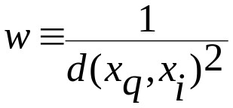
Discussion on the k-NN Algorithm
The k-NN algorithm for continuous-valued target functions
  Calculate the mean values of the k nearest neighbors
Distance-weighted nearest neighbor algorithm
  Weight the contribution of each of the k neighbors according to their distance to the query point x_{q}
    giving greater weight to closer neighbors
  Similarly, for real-valued target functions
Robust to noisy data by averaging k-nearest neighbors
Curse of dimensionality: distance between neighbors could be dominated by irrelevant attributes.
  To overcome it, axes stretch or elimination of the least relevant attributes.
Data Mining: Concepts and Techniques

Slide 13
Lazy vs. Eager Learning
Lazy vs. eager learning
  Lazy learning (e.g., instance-based learning): Simply stores training data (or only minor processing) and waits until it is given a test tuple
  Eager learning (the above discussed methods): Given a set of training set, constructs a classification model before receiving new (e.g., test) data to classify
Lazy: less time in training but more time in predicting
Accuracy
  Lazy method effectively uses a richer hypothesis space since it uses many local linear functions to form its implicit global approximation to the target function
  Eager: must commit to a single hypothesis that covers the entire instance space
Data Mining: Concepts and Techniques

Slide 14
Lazy Learner: Instance-Based Methods
Instance-based learning:
  Store training examples and delay the processing (“lazy evaluation”) until a new instance must be classified
Typical approaches
  k-nearest neighbor approach
    Instances represented as points in a Euclidean space.
  Locally weighted regression
    Constructs local approximation
  Case-based reasoning
    Uses symbolic representations and knowledge-based inference
Data Mining: Concepts and Techniques

Slide 15
Case-Based Reasoning (CBR)
CBR: Uses a database of problem solutions to solve new problems
Store symbolic description (tuples or cases)—not points in a Euclidean space
Applications: Customer-service (product-related diagnosis), legal ruling
Methodology
  Instances represented by rich symbolic descriptions (e.g., function graphs)
  Search for similar cases, multiple retrieved cases may be combined
  Tight coupling between case retrieval, knowledge-based reasoning, and problem solving
Challenges
  Find a good similarity metric
  Indexing based on syntactic similarity measure, and when failure, backtracking, and adapting to additional cases
Data Mining: Concepts and Techniques

Slide 16
Chapter 6. Classification and Prediction
What is classification? What is prediction?
Issues regarding classification and prediction
Classification by decision tree induction
Bayesian classification
Rule-based classification
Classification by back propagation
Support Vector Machines (SVM)
Associative classification
Lazy learners (or learning from your neighbors)
Other classification methods
Prediction
Accuracy and error measures
Ensemble methods
Model selection
Summary
Data Mining: Concepts and Techniques

Slide 17
What Is Prediction?
(Numerical) prediction is similar to classification
  construct a model
  use model to predict continuous or ordered value for a given input
Prediction is different from classification
  Classification refers to predict categorical class label
  Prediction models continuous-valued functions
Major method for prediction: regression
  model the relationship between one or more independent or predictor variables and a dependent or response variable
Regression analysis
  Linear and multiple regression
  Non-linear regression
  Other regression methods: generalized linear model, Poisson regression, log-linear models, regression trees
Data Mining: Concepts and Techniques

Slide 18
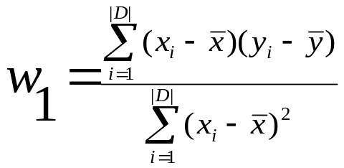
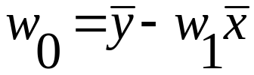
Linear Regression
Linear regression: involves a response variable y and a single predictor variable x
    y = w₀ + w₁ x
  where w₀ (y-intercept) and w₁ (slope) are regression coefficients
Method of least squares: estimates the best-fitting straight line
Multiple linear regression: involves more than one predictor variable
  Training data is of the form (X₁, y₁), (X₂, y₂),…, (X_{|D|}, y_{|D|})
  Ex. For 2-D data, we may have: y = w₀ + w₁ x₁+ w₂ x₂
  Solvable by extension of least square method or using SAS, S-Plus
  Many nonlinear functions can be transformed into the above
Data Mining: Concepts and Techniques

Slide 19
Nonlinear Regression
Some nonlinear models can be modeled by a polynomial function
A polynomial regression model can be transformed into linear regression model. For example,
    y = w₀ + w₁ x + w₂ x² + w₃ x³
  convertible to linear with new variables: x₂ = x², x₃= x³
    y = w₀ + w₁ x + w₂ x₂ + w₃ x₃
Other functions, such as power function, can also be transformed to linear model
Some models are intractable nonlinear (e.g., sum of exponential terms)
  possible to obtain least square estimates through extensive calculation on more complex formulae
Data Mining: Concepts and Techniques

Slide 20
Other Regression-Based Models
Generalized linear model:
  Foundation on which linear regression can be applied to modeling categorical response variables
  Variance of y is a function of the mean value of y, not a constant
  Logistic regression: models the prob. of some event occurring as a linear function of a set of predictor variables
  Poisson regression: models the data that exhibit a Poisson distribution
Log-linear models: (for categorical data)
  Approximate discrete multidimensional prob. distributions
  Also useful for data compression and smoothing
Regression trees and model trees
  Trees to predict continuous values rather than class labels
Data Mining: Concepts and Techniques

Slide 21
Regression Trees and Model Trees
Regression tree: proposed in CART system (Breiman et al. 1984)
  CART: Classification And Regression Trees
  Each leaf stores a continuous-valued prediction
  It is the average value of the predicted attribute for the training tuples that reach the leaf
Model tree: proposed by Quinlan (1992)
  Each leaf holds a regression model—a multivariate linear equation for the predicted attribute
  A more general case than regression tree
Regression and model trees tend to be more accurate than linear regression when the data are not represented well by a simple linear model
Data Mining: Concepts and Techniques

Slide 22
Predictive Modeling in Multidimensional Databases
Predictive modeling: Predict data values or construct generalized linear models based on the database data
One can only predict value ranges or category distributions
Method outline:
  Minimal generalization
  Attribute relevance analysis
  Generalized linear model construction
  Prediction
Determine the major factors which influence the prediction
  Data relevance analysis: uncertainty measurement, entropy analysis, expert judgement, etc.
Multi-level prediction: drill-down and roll-up analysis
Data Mining: Concepts and Techniques

Slide 23
Chapter 6. Classification and Prediction
What is classification? What is prediction?
Issues regarding classification and prediction
Classification by decision tree induction
Bayesian classification
Rule-based classification
Classification by back propagation
Support Vector Machines (SVM)
Associative classification
Lazy learners (or learning from your neighbors)
Other classification methods
Prediction
Accuracy and error measures
Ensemble methods
Model selection
Summary
Data Mining: Concepts and Techniques

Slide 24
Metrics for Performance Evaluation
Focus on the predictive capability of a model
  Rather than how fast it takes to classify or build models, scalability, etc.
Confusion Matrix:
 | PREDICTED CLASS
ACTUAL CLASS |  | Class=Yes | Class=No
 | Class=Yes | a | b
 | Class=No | c | d
a: TP (true positive)
b: FN (false negative)
c: FP (false positive)
d: TN (true negative)
Data Mining: Concepts and Techniques

Slide 25
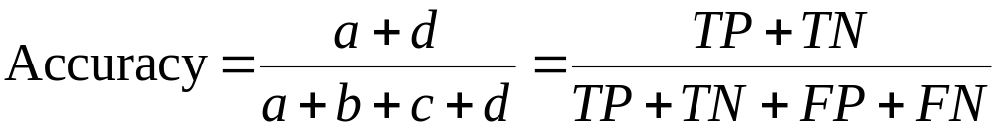
Metrics for Performance Evaluation…
 | PREDICTED CLASS
ACTUAL CLASS |  | Class=Yes | Class=No
 | Class=Yes | a (TP) | b (FN)
 | Class=No | c (FP) | d (TN)
Most widely-used metric:
Data Mining: Concepts and Techniques

Slide 26
Limitation of Accuracy
Consider a 2-class problem
  Number of Class 0 examples = 9990
  Number of Class 1 examples = 10
If model predicts everything to be class 0, accuracy is 9990/10000 = 99.9 %
  Accuracy is misleading because model does not detect any class 1 example
Data Mining: Concepts and Techniques

Slide 27
Cost Matrix
 | PREDICTED CLASS
ACTUAL CLASS | C(i|j) | Class=Yes | Class=No
 | Class=Yes | C(Yes|Yes) | C(No|Yes)
 | Class=No | C(Yes|No) | C(No|No)
C(i|j): Cost of misclassifying class j example as class i
Data Mining: Concepts and Techniques

Slide 28
Computing Cost of Classification
Cost Matrix | PREDICTED CLASS
ACTUAL CLASS | C(i|j) | + | -
 | + | -1 | 100
 | - | 1 | 0
Model M₁ | PREDICTED CLASS
ACTUAL CLASS |  | + | -
 | + | 150 | 40
 | - | 60 | 250
Model M₂ | PREDICTED CLASS
ACTUAL CLASS |  | + | -
 | + | 250 | 45
 | - | 5 | 200
Accuracy = 80%
Cost = 3910
Accuracy = 90%
Cost = 4255
Data Mining: Concepts and Techniques

Slide 29
Cost vs Accuracy
Accuracy is proportional to cost if
1. C(Yes|No)=C(No|Yes) = q
2. C(Yes|Yes)=C(No|No) = p
Count | PREDICTED CLASS
ACTUAL CLASS |  | Class=Yes | Class=No
 | Class=Yes | a | b
 | Class=No | c | d
N = a + b + c + d
Accuracy = (a + d)/N
Cost = p (a + d) + q (b + c)
= p (a + d) + q (N – a – d)
= q N – (q – p)(a + d)
= N [q – (q-p) × Accuracy]
Cost | PREDICTED CLASS
ACTUAL CLASS |  | Class=Yes | Class=No
 | Class=Yes | p | q
 | Class=No | q | p
Data Mining: Concepts and Techniques

Slide 30
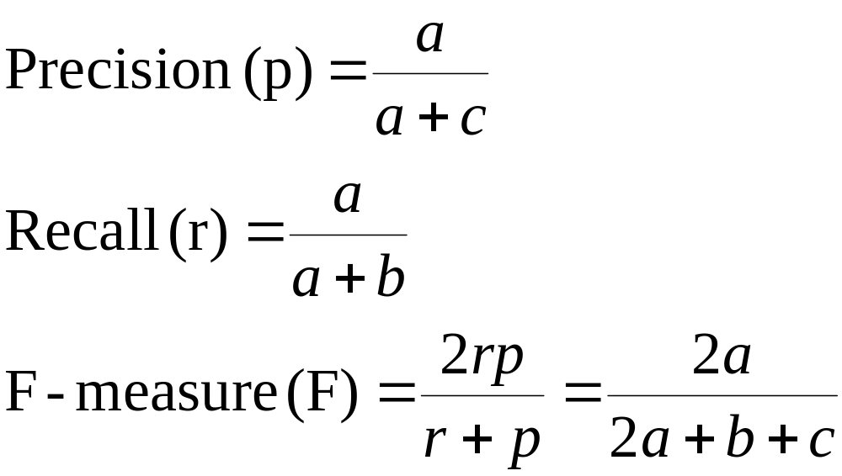
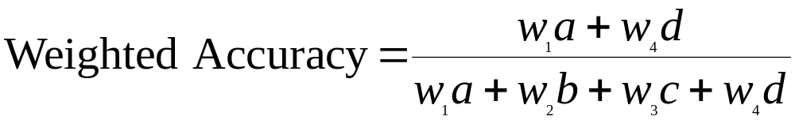
Cost-Sensitive Measures
Precision is biased towards C(Yes|Yes) & C(Yes|No)
Recall is biased towards C(Yes|Yes) & C(No|Yes)
F-measure is biased towards all except C(No|No)
Data Mining: Concepts and Techniques

Slide 31
More measures
True Positive Rate (TPR) (Sensitivity)
  a/a+b
True Negative Rate (TNR) (Specificity)
  d/c+d
False Positive Rate (FPR)
  c/c+d
False Negative Rate (FNR)
  b/a+b
Data Mining: Concepts and Techniques

Slide 32




Predictor Error Measures
Measure predictor accuracy: measure how far off the predicted value is from the actual known value
Loss function: measures the error betw. y_{i} and the predicted value y_{i}’
  Absolute error: | y_{i} – y_{i}’|
  Squared error: (y_{i} – y_{i}’)²
Test error (generalization error): the average loss over the test set
  Mean absolute error: Mean squared error:
  Relative absolute error: Relative squared error:
  The mean squared-error exaggerates the presence of outliers
  Popularly use (square) root mean-square error, similarly, root relative squared error
Data Mining: Concepts and Techniques

Slide 33
Evaluating the Accuracy of a Classifier or Predictor (I)
Holdout method
  Given data is randomly partitioned into two independent sets
    Training set (e.g., 2/3) for model construction
    Test set (e.g., 1/3) for accuracy estimation
  Random sampling: a variation of holdout
    Repeat holdout k times, accuracy = avg. of the accuracies obtained
Cross-validation (k-fold, where k = 10 is most popular)
  Randomly partition the data into k mutually exclusive subsets, each approximately equal size
  At i-th iteration, use D_{i} as test set and others as training set
  Leave-one-out: k folds where k = # of tuples, for small sized data
  Stratified cross-validation: folds are stratified so that class dist. in each fold is approx. the same as that in the initial data
Data Mining: Concepts and Techniques

Slide 34
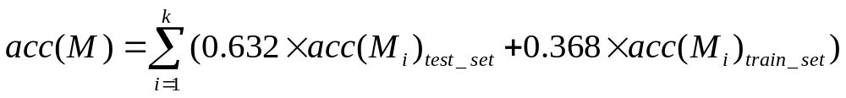
Evaluating the Accuracy of a Classifier or Predictor (II)
Bootstrap
  Works well with small data sets
  Samples the given training tuples uniformly with replacement
    i.e., each time a tuple is selected, it is equally likely to be selected again and re-added to the training set
Several boostrap methods, and a common one is .632 boostrap
  Suppose we are given a data set of d tuples. The data set is sampled d times, with replacement, resulting in a training set of d samples. The data tuples that did not make it into the training set end up forming the test set. About 63.2% of the original data will end up in the bootstrap, and the remaining 36.8% will form the test set (since (1 – 1/d)^{d} ≈ e⁻¹ = 0.368)
  Repeat the sampling procedue k times, overall accuracy of the model:
Data Mining: Concepts and Techniques

Slide 35
Chapter 6. Classification and Prediction
What is classification? What is prediction?
Issues regarding classification and prediction
Classification by decision tree induction
Bayesian classification
Rule-based classification
Classification by back propagation
Support Vector Machines (SVM)
Associative classification
Lazy learners (or learning from your neighbors)
Other classification methods
Prediction
Accuracy and error measures
Ensemble methods
Model selection
Summary
Data Mining: Concepts and Techniques

Slide 36
Ensemble Methods
Construct a set of classifiers from the training data
Predict class label of previously unseen records by aggregating predictions made by multiple classifiers
Data Mining: Concepts and Techniques

Slide 37

Ensemble Methods: Increasing the Accuracy
Ensemble methods
  Use a combination of models to increase accuracy
  Combine a series of k learned models, M₁, M₂, …, M_{k}, with the aim of creating an improved model M*
Popular ensemble methods
  Bagging: averaging the prediction over a collection of classifiers
  Boosting: weighted vote with a collection of classifiers
  Ensemble: combining a set of heterogeneous classifiers
Data Mining: Concepts and Techniques

Slide 38
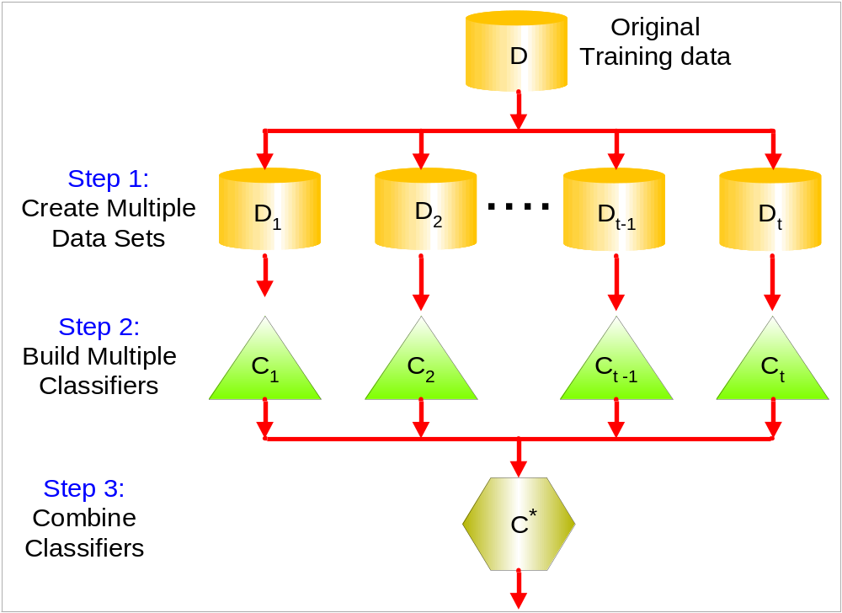
General Idea
Data Mining: Concepts and Techniques

Slide 39
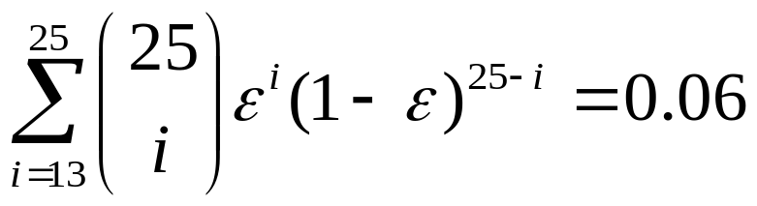
Why does it work?
Suppose there are 25 base classifiers
  Each classifier has error rate, ε = 0.35
  Assume classifiers are independent
  Probability that the ensemble classifier makes a wrong prediction:
Data Mining: Concepts and Techniques

Slide 40
Examples of Ensemble Methods
How to generate an ensemble of classifiers?
  Bagging
  Boosting
Data Mining: Concepts and Techniques

Slide 41
Bagging: Boostrap Aggregation
Analogy: Diagnosis based on multiple doctors’ majority vote
Training
  Given a set D of d tuples, at each iteration i, a training set D_{i} of d tuples is sampled with replacement from D (i.e., boostrap)
  A classifier model M_{i} is learned for each training set D_{i}
Classification: classify an unknown sample X
  Each classifier M_{i} returns its class prediction
  The bagged classifier M* counts the votes and assigns the class with the most votes to X
Prediction: can be applied to the prediction of continuous values by taking the average value of each prediction for a given test tuple
Accuracy
  Often significant better than a single classifier derived from D
  For noise data: not considerably worse, more robust
  Proved improved accuracy in prediction
Data Mining: Concepts and Techniques

Slide 42
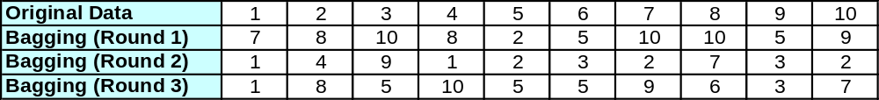
Bagging
Sampling with replacement
Build classifier on each bootstrap sample
Each sample has probability (1 – 1/n)^{n} of being selected
Data Mining: Concepts and Techniques

Slide 43
Boosting
An iterative procedure to adaptively change distribution of training data by focusing more on previously misclassified records
  Initially, all N records are assigned equal weights
  Unlike bagging, weights may change at the end of boosting round
Data Mining: Concepts and Techniques

Slide 44
Boosting
Analogy: Consult several doctors, based on a combination of weighted diagnoses—weight assigned based on the previous diagnosis accuracy
How boosting works?
  Weights are assigned to each training tuple
  A series of k classifiers is iteratively learned
  After a classifier M_{i} is learned, the weights are updated to allow the subsequent classifier, M_{i+1}, to pay more attention to the training tuples that were misclassified by M_{i}
  The final M* combines the votes of each individual classifier, where the weight of each classifier's vote is a function of its accuracy
The boosting algorithm can be extended for the prediction of continuous values
Comparing with bagging: boosting tends to achieve greater accuracy, but it also risks overfitting the model to misclassified data
Data Mining: Concepts and Techniques

Slide 45
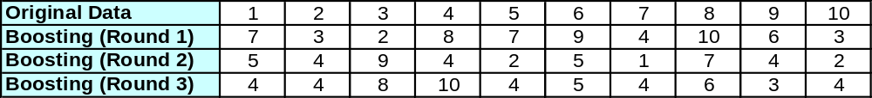
Boosting
Records that are wrongly classified will have their weights increased
Records that are classified correctly will have their weights decreased
Example 4 is hard to classify
Its weight is increased, therefore it is more likely to be chosen again in subsequent rounds
Data Mining: Concepts and Techniques

Slide 46


Adaboost (Freund and Schapire, 1997)
Given a set of d class-labeled tuples, (X₁, y₁), …, (X_{d}, y_{d})
Initially, all the weights of tuples are set the same (1/d)
Generate k classifiers in k rounds. At round i,
  Tuples from D are sampled (with replacement) to form a training set D_{i} of the same size
  Each tuple’s chance of being selected is based on its weight
  A classification model M_{i} is derived from D_{i}
  Its error rate is calculated using D_{i} as a test set
  If a tuple is misclssified, its weight is increased, o.w. it is decreased
Error rate: err(X_{j}) is the misclassification error of tuple X_{j}. Classifier M_{i} error rate is the sum of the weights of the misclassified tuples:
The weight of classifier M_{i}’s vote is
Data Mining: Concepts and Techniques

Slide 47
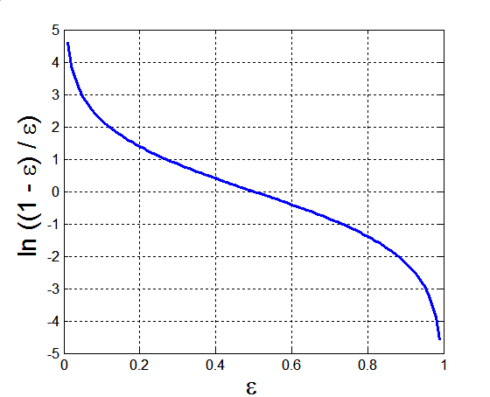
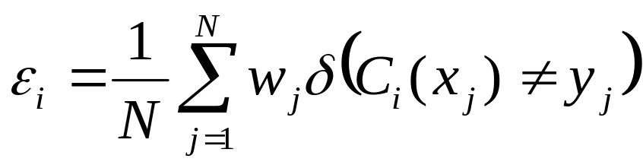
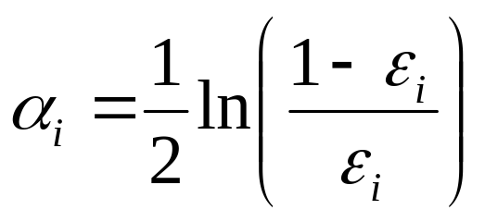
Example: AdaBoost
Base classifiers: C₁, C₂, …, C_{T}
Error rate:
Importance of a classifier:
Data Mining: Concepts and Techniques

Slide 48
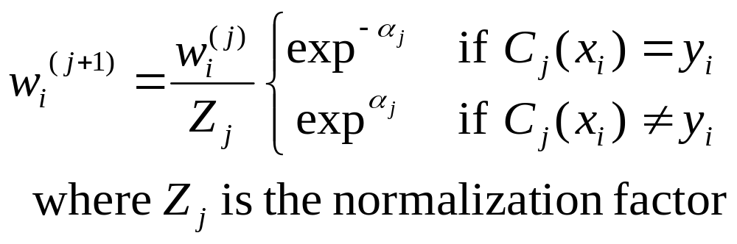
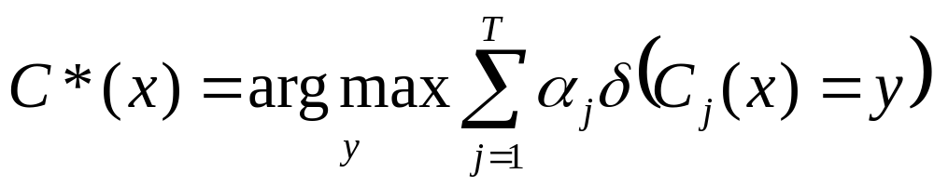
Example: AdaBoost
Weight update:
If any intermediate rounds produce error rate higher than 50%, the weights are reverted back to 1/n and the resampling procedure is repeated
Classification:
Data Mining: Concepts and Techniques

Slide 49
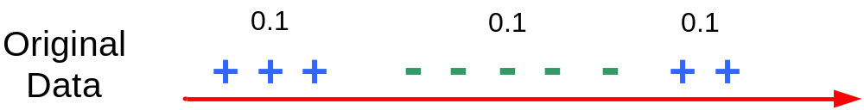
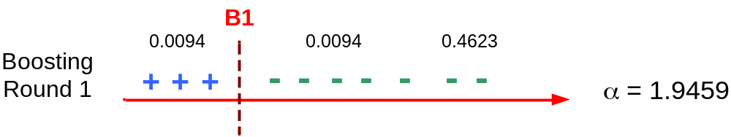
Illustrating AdaBoost
Initial weights for each data point
Data points for training
Data Mining: Concepts and Techniques

Slide 50
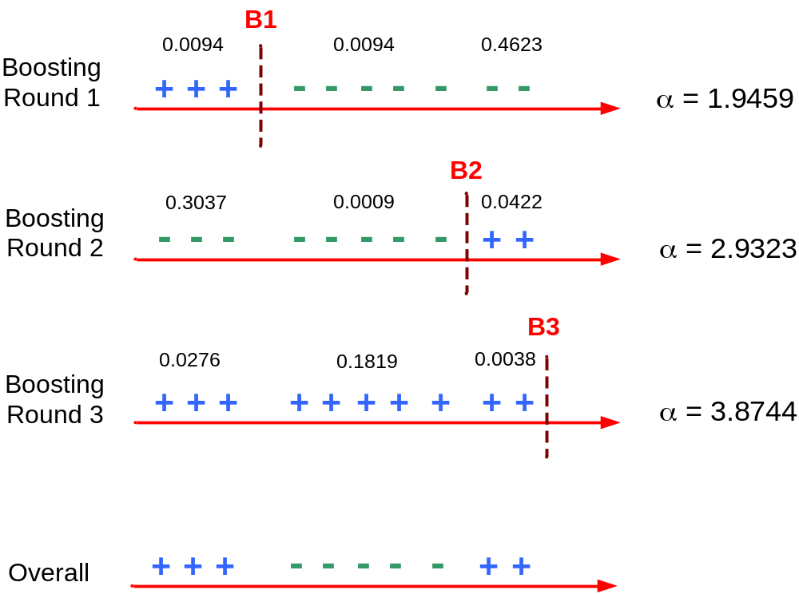
Illustrating AdaBoost
Data Mining: Concepts and Techniques

Slide 51
Chapter 6. Classification and Prediction
What is classification? What is prediction?
Issues regarding classification and prediction
Classification by decision tree induction
Bayesian classification
Rule-based classification
Classification by back propagation
Support Vector Machines (SVM)
Associative classification
Lazy learners (or learning from your neighbors)
Other classification methods
Prediction
Accuracy and error measures
Ensemble methods
Model selection
Summary
Data Mining: Concepts and Techniques

Slide 52
Summary (I)
Classification and prediction are two forms of data analysis that can be used to extract models describing important data classes or to predict future data trends.
Effective and scalable methods have been developed for decision trees induction, Naive Bayesian classification, Bayesian belief network, rule-based classifier, Backpropagation, Support Vector Machine (SVM), associative classification, nearest neighbor classifiers, and case-based reasoning, and other classification methods such as genetic algorithms, rough set and fuzzy set approaches.
Linear, nonlinear, and generalized linear models of regression can be used for prediction. Many nonlinear problems can be converted to linear problems by performing transformations on the predictor variables. Regression trees and model trees are also used for prediction.
Data Mining: Concepts and Techniques

Slide 53
Summary (II)
Stratified k-fold cross-validation is a recommended method for accuracy estimation. Bagging and boosting can be used to increase overall accuracy by learning and combining a series of individual models.
Significance tests and ROC curves are useful for model selection
There have been numerous comparisons of the different classification and prediction methods, and the matter remains a research topic
No single method has been found to be superior over all others for all data sets
Issues such as accuracy, training time, robustness, interpretability, and scalability must be considered and can involve trade-offs, further complicating the quest for an overall superior method
Data Mining: Concepts and Techniques

